Slide 1
Using Templates
A Better Way to Inject HTML into NODE

Slide 2
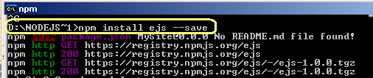
Use EJS
Install the ejs plugin to your website
Create a folder in the root called ‘views’

Slide 3
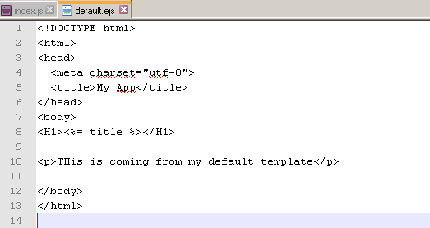
Typical Template Page
Just regular HTML but saved into the views folder as default.ejs
It is setup to receive a <%= title %>

Slide 4
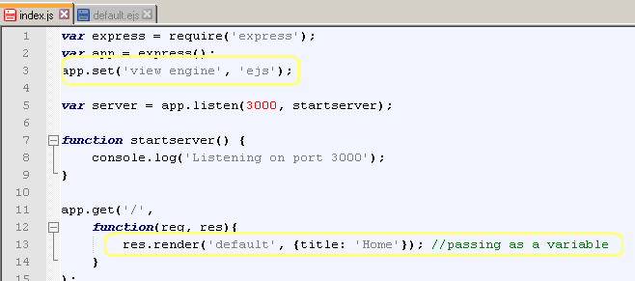
Changes Made to index.js
Set the view engine on line 3 to ‘ejs’
On the home page instead of res.send it becomes res.render, with the name of the template, and to pass in the title, add {title: ‘Home’}

Slide 5
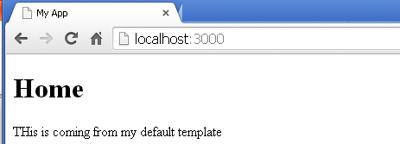
Here’s What You Get
Restart the server and go to the home page

Slide 6
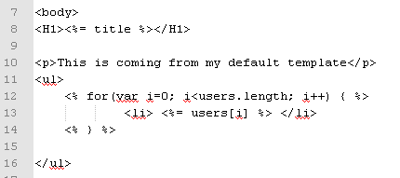
Sending In An Array
Use <% and %> to embed javascript code into the template.
Here is a for loop that goes through a list of users and prints them

Slide 7
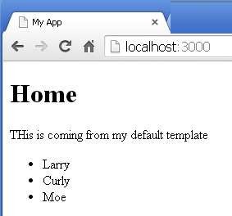

Send it FROM index.js
Along with title, we are now sending in a list of users too:

Slide 8
Breaking Home Page into Partials
A Partial is a section of the page that is in another file.
Web developers will often take parts of a page that will show up on many pages and store them in a partial
So we can take our original index page and break it out into separate partials

Slide 9
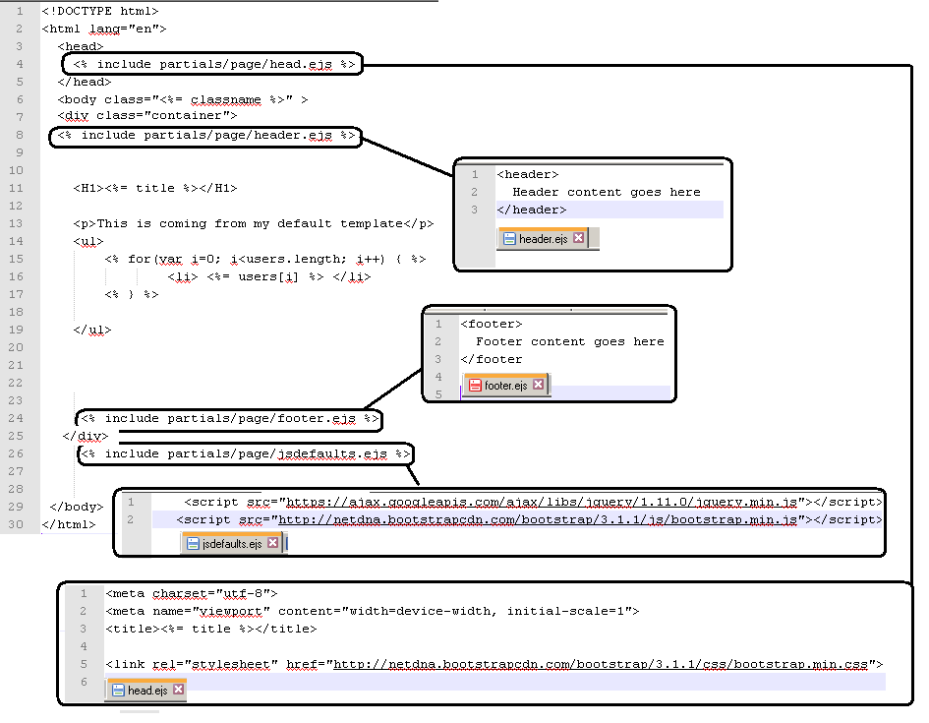

Slide 10
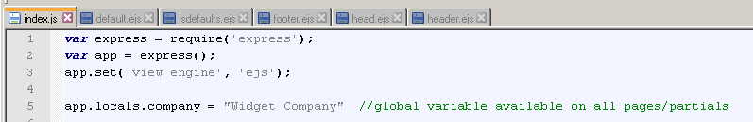

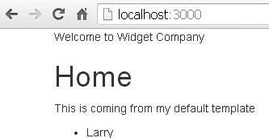
Global Variables
This (on default template)
Plus this (in header partial)
Equals this (on webpage)

Slide 11
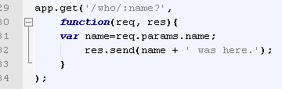

Passing Data as parameter URL
If we define a route /who with a variable called /:name?
We can use req to request the name as the user types it into the web address: var name=req.params.name;
Then we can do this

Slide 12
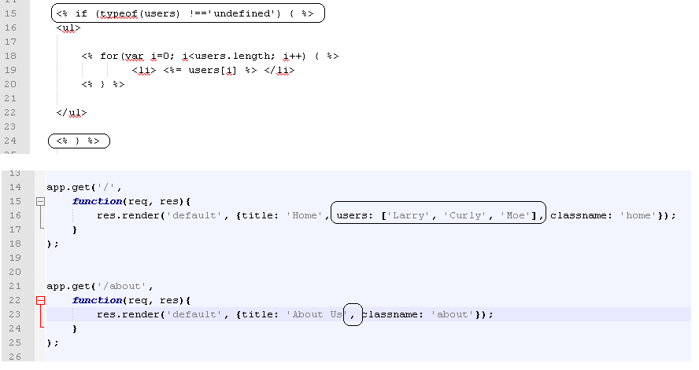
Using IF to decide what to show
If we render the same template
In the home AND about routes,
We can decide if we will use the user list or not in the default.ejs file

Slide 13
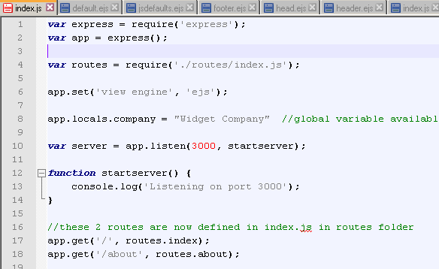
Cleaning Up The Index Page
We can change index to point to another page in a routes folder that defines the main routes
..and re-write the home and about routes to look like this

Slide 14
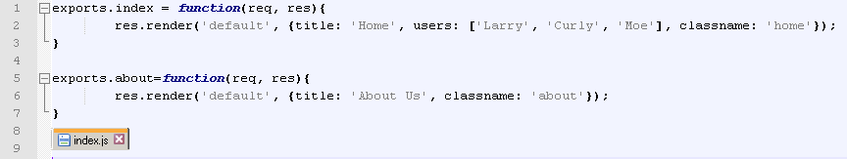
That Page Looks Like This
We use exports.index and exports.about to create the function that renders the default template.
The old way, we defined the function right in the app.get command
Vs. the OLD WAY

